Slide 1
S1. Introduction to LSCM
Logistics Course 1
“Fundamentals of Logistics and Supply Chain Management”
July 2026
Logistics Institute of Central Asia
Kyrgyz Republic, Bishkek

Slide 2
Mega-Trends in Logistics
Growth of E-commerce
Relentless Competition
Urbanization
Mobile & Wearbale Computing
Robotice & Automation
Sensors & The Internet of Things
Big Data & Predictive Analytics
Source: www.forbes.com

Slide 3
The importance of logistics for the economy/business
Logistics and the Economy
Logistics Performance Index (LPI) by the World Bank
Efficiency of the clearance process (i.e., speed, simplicity and predictability of formalities) by border control agencies, including customs;
Quality of trade and transport related infrastructure (e.g. ports, railroads, roads, information technology);
Ease of arranging competitively priced shipments;
Competence and quality of logistics services (e.g. transport operators, customs brokers);
Ability to track and trace consignments;
Timeliness of shipments in reaching destination within the scheduled or expected delivery time.

Slide 4

LPI of Central Asia Countries
The Logistics Performance Index (LPI) is an interactive benchmarking tool that helps countries identify challenges and opportunities in trade logistics and ways to improve performance.
(2023 LPI covers 139 countries)
Country | Year | LPI score | Customs | Infrastructure | International shipments | Logistics competence | Tracking & tracing | Timeliness | Rank
Kazakhstan | 2023 | 2.7 | 2.6 | 2.5 | 2.6 | 2.7 | 2.8 | 2.9 | #79
Uzbekistan | 2023 | 2.6 | 2.6 | 2.4 | 2.6 | 2.6 | 2.4 | 2.8 | #88
Tajikistan | 2023 | 2.5 | 2.2 | 2.5 | 2.5 | 2.8 | 2 | 2.9 | #97
Kyrgyzstan | 2023 | 2.3 | 2.2 | 2.4 | 2.4 | 2.2 | 2.3 | 2.4 | #123
Turkmenistan | No data
Source: https://lpi.worldbank.org/about
M10:U1:1.1-1

Slide 5
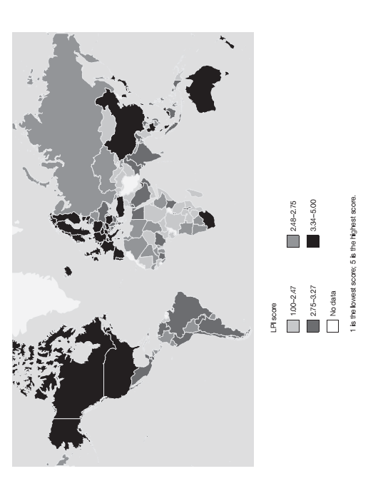
Logistics and the Economy
2014 Global LPI and Regional LPI Ranking
Russia Rank #90
Kazakhstan #88
Turkey #30
China #28
Tajikistan Rank #114
Uzbekistan Rank #129
Turkmenistan Rank #140
Iraq Rank #141
Kyrgyzstan Rank # 149
Afghanistan Rank #158
1 is the lowest score, 5 is the highest score

Slide 6
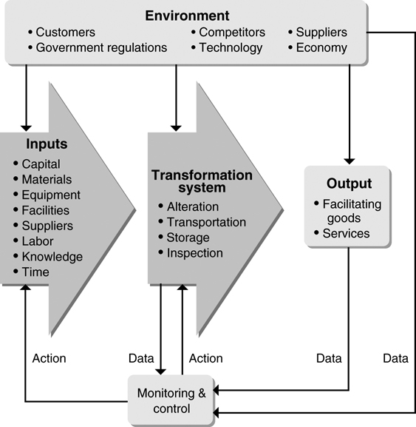
Operations : Production System / Transformation Process
The essence of the operations function is to add value during the transformation process, with a feedback process : value-added is the term used to describe the difference between the cost of inputs and the value or price of outputs.

Slide 7
A Company Interacting with
its Competitive Environment
A Holistic Systems View of Doing Business
Sophisticated Customer Demand
Shorter Product Life Cycles
Technology Advance
Sustainability
World Environment
Ethics & Governance
Crude Oil Shortages
Immediate Environment
Competitors
Competing Supply Chains
Exchange rates
Banks
Taxes
Suppliers
Inputs
Company
Transformation
Outputs
Customers
Technology
Shareholders
Trade Unions
World Trade
Government Regulations
Demand for new products
World Economies
Globalization

Slide 8
Ecomonic/Business Power of LSCM
Ecological Challenges
Transportation and logistics accounts for
  22% of global energy use
  23% of world energy-related CO2 emissions
By 2030, we’ll need ~2 earths to sustain humanity and our culture and life style.

Slide 9
Ecomonic/Business Power of LSCM
Sustainable Development
Increasing interest in having the sustainable development
Need to integrate the social, economic and environmental dimensions of development, known as the three dimensions of sustainable development

Slide 10

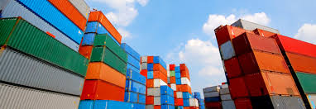
LSCM Strategy

Slide 11

What is Logistical Activity?
Logistical activity has been one of the oldest and vital economic activity
Moving goods throughout a chain of suppliers, from manufactures to distributors to wholesalers to retailers to customers
Requiring activities for transportation, inventory, warehousing, packaging, etc.
Logistics: the science and practical management of the supply of materials
The right type(s) of material(s)
In the right quantity(s)
In the right condition
To the right location(s) and customer
At the right time(s)
For the right cost
Delivered with the right tailored services required by the buyer
With the right information needed by the customer during & at the end of the logistics process
?
“that part of the supply chain process that plans, implements and controls the efficient, effective flow and storage of goods, services and related information from the point-of-origin to the point-of-consumption in order to meet customer requirements“
© Denny J. Cho

Slide 12

Logistics Stages
Inbound logistics: the transportation of goods into the purchasing organisation‘s main warehouse
Internal distribution: materials management – the movement of goods within a firm
Outbound logistics: the distribution flow of goods from the organisation to a subsequent customer
Integrated approach: linking these stages to meet corporate objectives; also integration within the supply chain
S2-4
M10:U1:1.1-3

Slide 13
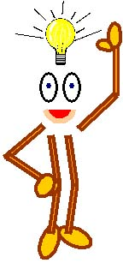
What is Supply Chain Management?
Supply chain management is:
“the management of upstream & downstream relationships with suppliers & customers to deliver superior customer value at less cost to the supply chain as a whole“
Supply chain management does not just take into consideration material flow from the supplier to the customer but also information & financial flows throughout the supply chain
S2-10
M10:U1:1.2-2

Slide 14
Objectives of Supply Chain Management
To arrange for the
efficient and cost_
-effective movement
of all material
products, and related information to the location where needed at the
lowest total cost across the entire system.
Emphasis is not only simply reducing transportation cost or reducing
inventory cost, but taking a systems approach to reduce
total system-
wide costs.
Design and manage a balanced supply chain to maximize the profit
ability
•
Minimize variance to improve logistical productivity (Probability)
•
Reduce inventory to the maximum extent possible (Inventory Management)
•
Maximize transportation consolidation (Transportation)
•
Achieve and maintain high levels of product quality (Quality Control)
•
Provide life
cycle support (Support Service)
The mission of logistics/SCM
The 5 “Rights”
The 5 “Rights”
Getting RIGHT goods or service to the RIGHT place,
Getting RIGHT goods or service to the RIGHT place,
in the RIGHT amount, at the RIGHT time, in the RIGHT condition,
in the RIGHT amount, at the RIGHT time, in the RIGHT condition,
while making the greatest profit
while making the greatest profit
© Denny J. Cho

Slide 15
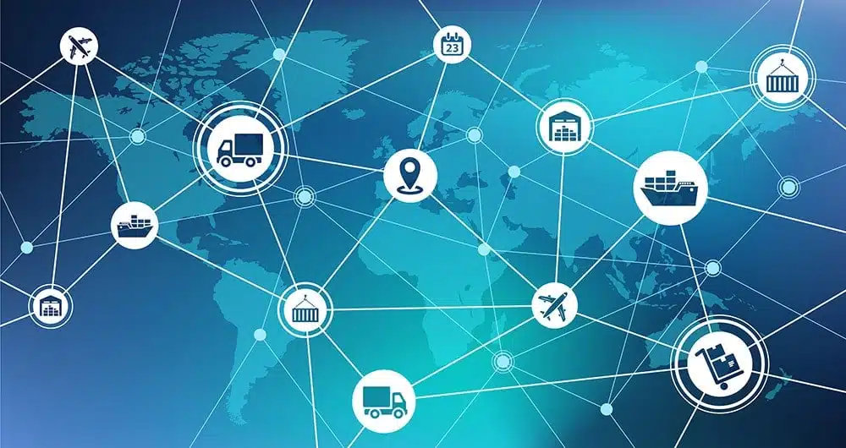
SCM: A Cross-Functional Activity
Started in 1980s with PC Innovation
Superior Customer Value and Max Profitability
Supply Chain Management =
Logistics
+
Manufacturing Operations
+
Marketing Coordination
+
Sales Coordination
+
Product Design
+
Finance
+
Information Technology
Notes:
Supply chain management really started in 1980s with PC innovation.
It is the management of upstream & downstream relationships
to deliver superior customer value,
to maximize profitability across the entire supply chain while satisfying the end customers
It is a cross-functional activity, involving many functions, such as operations, marketing, and production and finance.

Slide 16
Logistics vs Supply Chain Management
Logistics management involves the strategy & operations relating to the movement of goods within the enterprise & with its immediate suppliers & customers.
Supply chain management involves managing the relationships amongs all members in the supply chain.
A company‘s Logistics strategy needs to be closely aligned with the supply chain‘s overall strategy.
S2-14
M10:U1:1.2-3

Slide 17
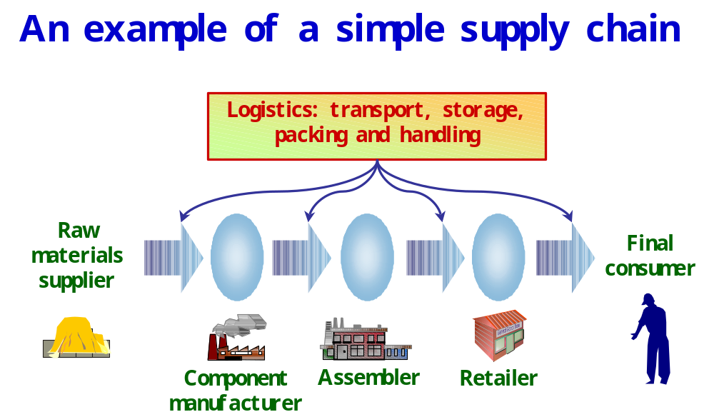
An Example of a Simple Supply Chain
S2-11
M10:U1:1.2-6

Slide 18
Supplier
Supplier

Slide 19
Processes Involved in a Supply Chain
Value Added Inventory Flow
Replenishment
Procurement
1. Retail order trigger
1. Order from Mfg
(inventory low)
2. Supplier production scheduling
2. Retail order entry
3. Component manufacturing/shipping
3. Retail order fulfillment
4. Order receiving by Mfg
4. Retail order receiving
Suppliers
Manufacturers
Distributors
Retailers
Consumers
Manufacturing
Customer order
1. Order arrival from Distr.
1. Order arrival
2. Production scheduling
(retail stores
3. Manufacturing & shipping
call/mail order center,
4. Order receiving by Distr.
website)
2. Order entry
3. Order fulfillment
4. Order receiving
Requirements Information Flow
© Denny J. Cho

Slide 20
The Four Interrelated Flows in SCM
1. Product & Service Flows:
The value-adding flow, as products & services progress along the supply chain from point of origin to point of final use or consumption. Generally flow downstream the chain but also upstream (e.g. reprocessing)
2. Information Flows:
The bi-directional flows of information throughout the chain – particularly on customer demand which “pulls” the supply chain, but also on supply conditions & eventual disruptions
3. Funds Flows:
The flows of funds, mainly upstream (payments for goods & services received) but also in some cases downstream
4. Expertise & Technology Flows:
Sharing in areas such as IT systems, SCM expertise, product design, marketing, developing joint SC performance indicators, etc.

Slide 21
Aspects of Supply Chain Design & Strategy
Supply Chain Decisions
TIME FRAME
TYPE
•
Supply chain strategies
(Sell direct or through
retailers? Outsource or in
-
house? Focus on cost or
years
Strategic
customer service?)
•
Supply chain network design (How many plants?)
(Location and capacities of plants and warehouses?)
•
Product mix at each plant
•
Purchasing & Production planning
3 mos.
- 1 year
Tactical
•
Inventory policies (safety stock level)
•
Which locations supply which markets
•
Transportation strategies
•
Production scheduling
daily
Operational
•
Distribution scheduling and routing
•
Place inventory replenishment orders
•
Lead time quotations
•
Material handling
© Denny J. Cho

Slide 22
Effective & Efficient Supply Chains
Key factors:
  Understanding end customer needs
  Adopting effectice supply chain stategies to meet end customer needs
  Integration of the members of the supply chain
  Successfully tackling operational issues
  Successfully handling the impact of internationalisation on the supply chain
  Managing the information systems & technology which hold the supply chain together
  Ensuring value for the customer provided by the supply chain
S2-13
M10:U1:1.2-8

Slide 23
Without sophisticated LSCM
20
15
10
5
0
Sales: Retailer to End user
20
15
10
5
0
Sales: Wholesaler to Retailer
Order size
Order size
20
15
10
5
0
Time
20
15
10
5
0
Time
Sales: Manufacturer to Wholesaler
Sales: Supplier to
Manufacturer
Order size
Order size
Time
Time
Kersten, 2014

Slide 24
With sophisticated LSCM
20
15
10
5
0
Sales: Retailer to End user
20
15
10
5
0
Sales: Wholesaler to Retailer
Order size
Order size
20
15
10
5
0
Time
20
15
10
5
0
Time
Sales: Manufacturer to Wholesaler
Sales: Supplier to
Manufacturer
Order size
Order size
Time
Time
Kersten, 2014

Slide 25
Supply Chain Examples
Example 1: Wal-Mart
Procter & Gamble
Wal
-
Mart
Customers Request:
or 3rd Party
Wal
-
Mart
Buying detergent,
Da
-
Fa Clothing, Inc. (China)
Distribution
stores
clothes, TV, …...
Centers (DCs)
SONY Factory (Malaysia)
Fabric Producer
Electronics Components Producer
Plastic Producer
Zipper Producer
Plastic Producer
Chemical Producer
Thread Producer
© Denny J. Cho

Slide 26
Example 2: Hewlett Packard (HP)
Suppliers
IC Mfg
US DCs
Retailer
Consumers
FAT
Europe
Suppliers
PC Board
DCs
Retailer
Consumers
Suppliers
Subassembly
Far East
DCs
Retailer
Consumers
Suppliers
FAT = Final Assembly & Test
IC Mfg = Integrated Circuit manufacturing
PC Board = Printed Circuit Board
© Denny J. Cho

Slide 27
Example 3: Dell
Monitors by SONY (Mexico)
Keyboards by Acer (Taiwan)
Dell
Assembly
Customers
-
CPU by Intel (USA)
Plant
Other components
Note that there are no movements to
or from retail stores in this process
© Denny J. Cho

Slide 28
Key Issues in Supply Chain Management
Complex SC Environments
1. Constantly changing logistical environments
-
Financial: Inflation and Interests
-
Technology: Computer, Communication,
Material Handling, and Transportation
-
Regulatory: Transportation and Communication
-
Energy: Price and Availability
-
Population: Demand and Workforce
2. Requires a strategic logistical/SCM plan to
-
Integrate all parts/processes (Systems Optimization)
-
Gain advantages in cost/service (Competitiveness)
-
Posture for uncertainty/changes (Flexibility)
Designing an SC is not easy
© Denny J. Cho

Slide 29
Key Issues in Supply Chain Management
Complex SC Environments
3. Uncertain customer demand
-
High fluctuation over time
-
Difficult to forecast
=> Results in stock-outs or excessive inventory
4. Conflicting local objectives across the supply chain
Manufacturers
Distributors
Retailers
Consumers
Large production batches
Low inventory
Few stores
Convenience
Few DCs
Low inventory
Short lead time
Little variety
Large variety of
Close to DCs
products
Large shipments
Managing an SC is not easy, either!
© Denny J. Cho

Slide 30
Push vs. Pull Processes
PUSH
: Processes initiated in
anticipation
to customer orders
PULL
: Processes initiated in
response
to customer orders
Suppliers
Manufacturers
Distributors
Wal
-
Mart
Customers
Procurement
Manufacturing
Replenishment
Customer order
process
process
process
process
PUSH PROCESSES
PULL PROCESSES
Suppliers
Dell
Customers
Procurement
Manufacturing
Customer order
process
process
process
PUSH PROCESSES
PULL PROCESSES
© Denny J. Cho

Slide 31
Postponement
Postponement or ‘push-pull‘ strategies aim at preventing the disadvantages of both push & pull strategies
Under postponement, certain parts of the supply chain are undertaking a push strategy while other parts perform a pull strategy:
  Upstream suppliers provide commodity parts & components using a push strategy as demand is smoother & more predictable
  Downstream suppliers employ a pull strategy & do not customise products & services until an order from the final customer has been made
M10:U2:2.3-6

Slide 32
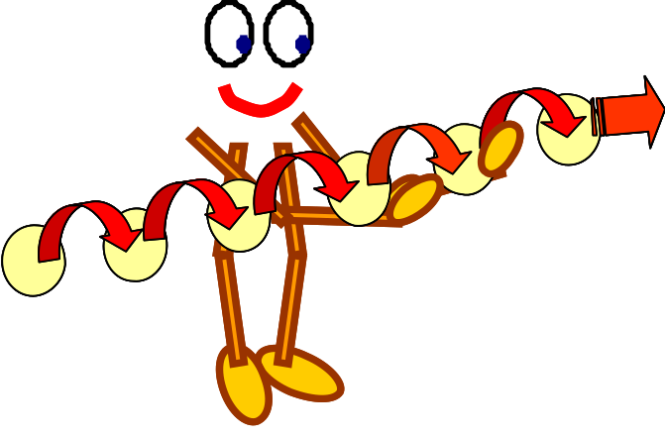
Information within the Supply Chain
This includes information about:
customer demand, inventory levels, production…
Information shared by all members throughout the supply chain is crucial for performance & decision-making!
Key demands:
Accuracy
Timeliness
The organisation needs to have appropriate information systems, relative to its strategy & business environment
M10:U6:6.1-1

Slide 33

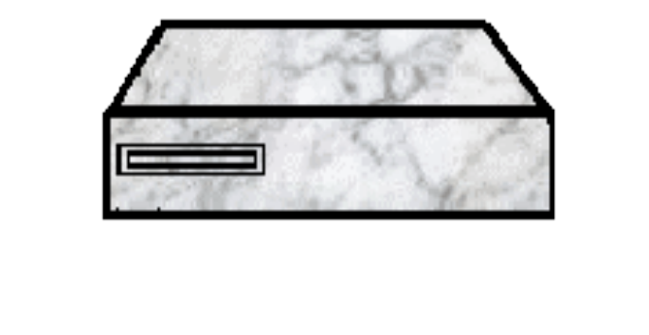
Engineering
Operations
Engineering
Engineering
Human
Sales &
Resources
Marketing
Central Database
Supplier
Central Database
Customer
and Servers
Relationship
and Servers
Relationship
Management
Management
Finance &
Logistics
Accounting
Headquarters
and Branches

Slide 34
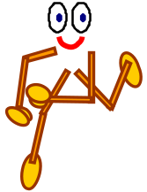
3PL Providers
3PL (third party logistics) providers are outside companies which perform all or part of the material managmeent & distribution function for the supply chain
3PL providers are asset-based & offer a range of services & long-term relationships
Advantages:
  Companies that use 3PL can focus their activities on their real strengths
Disadvantages:
  Loss of contact with customer can result in loss of market, supplier and customer knowledge
M10:U2:2.6-1

Slide 35
4PL Providers
4PL (fourth party logistics) providers take the concept of 3PL a stage further & provide all services related to the management & coordination of the entire supply chain
4PL providers are information-based & use information to both operationally & strategically coordinate & manage the supply chain
4PL often manage several 3PL providers where the 3PL provide the physical material management & distribution, whereas the 4PL uses information to optimise the supply chain
M10:U2:2.6-2

