Slide 1
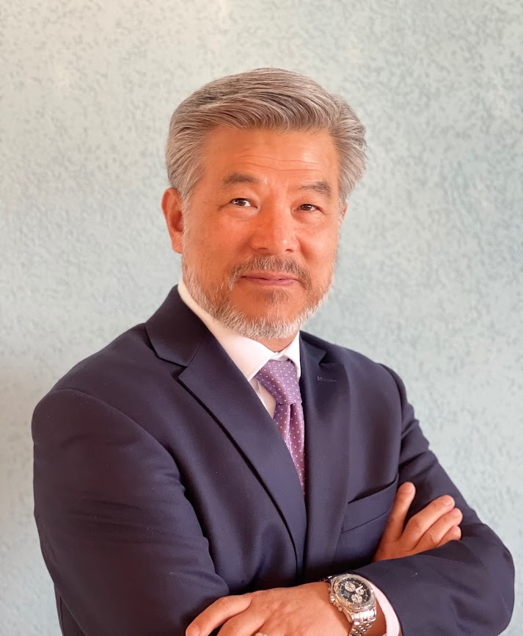




Contact Details
Prof. Dr. Denny J. Cho
President/Founder
Global Technology Solutions, LLC
Logistics Institute of Central Asia
Bishkek, Kyrgyz Republic 720060
Phone: 996 558 694 222
Email: cho.denny@glotechsol.com
Emiratus/Honoary Professor
Logistics Institute of Central Asia
Kyrgyz State Technical University
Bishkek, Kyrgyz Republic 720060
Email: cho.denny@gmail.com

